Slide 1


AI Model Helps Missing Child
AI is revolutionizing missing child recovery, offering hope and faster solutions to families.
by Aml Banna

Slide 2
The Missing Child Crisis
Scope
Impact
Millions of children go missing each year.
Trauma, fear, and long-lasting effects on families.

Slide 3

How Artificial Intelligence is Solving the Problem
Data Analysis
Facial Recognition
Identifying patterns and predicting potential risks.
Matching missing children to images from various sources.
Social Media Monitoring
Tracking online activity and potential leads.

Slide 4
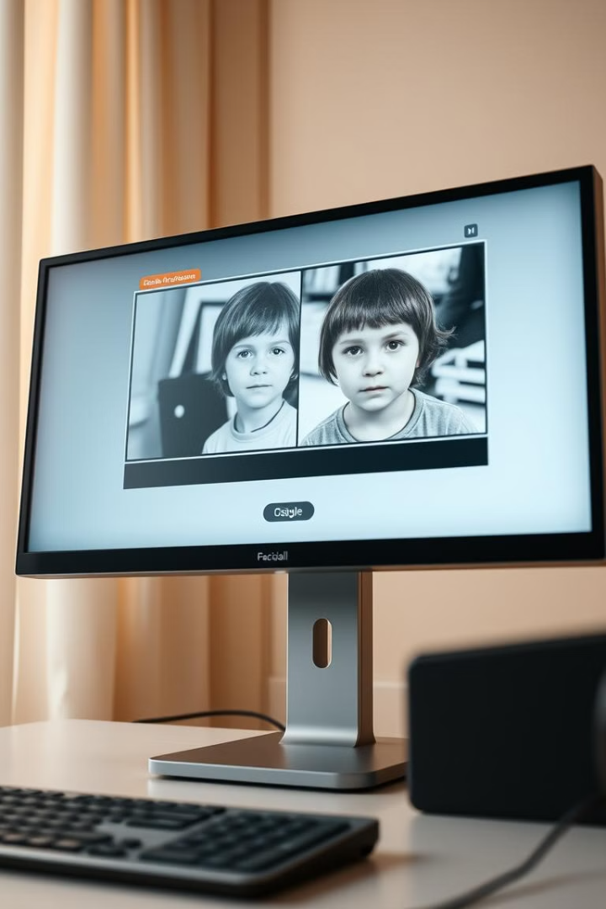
Tools Empowering the Solution
1
OpenCV for facial recognition.
2
TensorFlow/PyTorch for model training.
3
Cloud platforms like AWS for large-scale deployment.
4
Database tools for storing and managing vast datasets.

Slide 5





Methodologies
Data collection from missing child reports and surveillance footage.
Preprocessing: Noise reduction, image enhancement.
Model training with labeled datasets.
Integration with real-time surveillance systems.

Slide 6
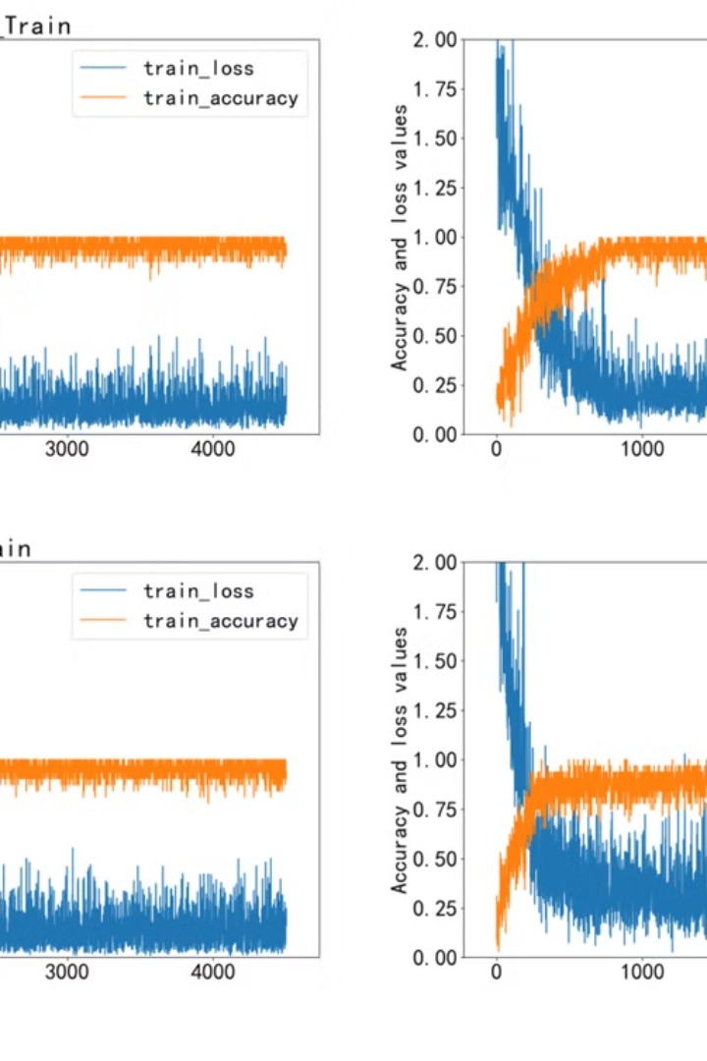
ModelS
1
ResNet50
2
SVM
3
Hybrid model embedding both

Slide 7
Deployment

Slide 9
Challenges
Integrating data from diverse sources.
Enhancing model accuracy with limited labeled data
Adjusting parameters to reduce false positives/negatives.
Handling real-time data processing at scale

Slide 10
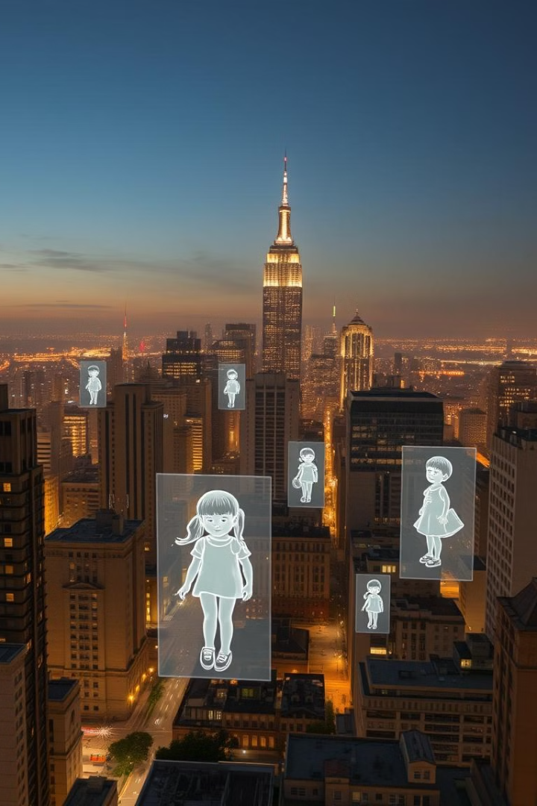
The Road Ahead
We aim to leverage advanced quantum computing and computer vision technologies to enhance the efficiency of locating missing children. Our vision includes:
Integrating Databases: Connecting the missing children databases with security centers and, where possible, public places to enable real-time identification.
Providing Dedicated Databases: Establishing centralized and accessible repositories for tracking and identifying missing children efficiently.
Facilitating Communication: Ensuring seamless communication channels for reporting and informing families upon identification of their loved ones.

Slide 11

حمدالله عالسلامة وقدر ولطف…….

